Slide 1
Assignment - 1
Introduction to Financial Engineering
Group 5
Aman Vashishth (B20MT005)

Slide 2
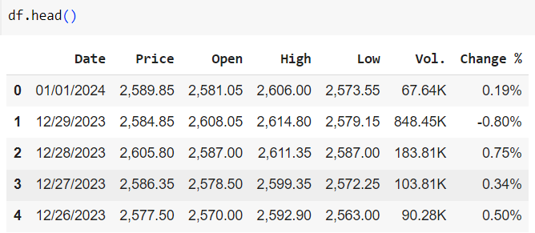
Asset Chosen :- Reliance Industries
Data was collected for the three years starting from 1 Jan 2021 to 1 Jan 2024.
Data consists of opening price , closing price , volume traded , high , low etc. . Out of which closing price was used modelling purpose

Slide 3
Technical Indicators
Technical indicators are heuristic or mathematical calculations based on the price, volume, or open interest of a security or contract used by traders who follow technical analysis.
Four technical indicators was calculated using data :-
Moving Average (MA)
Relative Strength Index (RSI)
Bollinger Bands
MACD (Moving Average Convergence Divergence)

Slide 4
Methodology
Technical Indicators was calculated. Technical indicators were chosen as per our requirements.
In case of moving average window_size is chosen as 10.
In case of RSI window_size is chosen as 14.
In case of Bollinger_Band window_size is 10
In case of MACD is calculated by subtracting the 26-period EMA from the 12-period EMA.

Slide 5
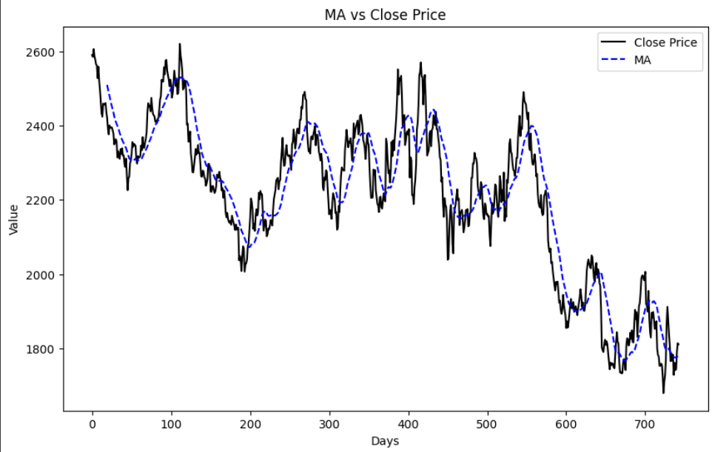

Moving Average
We used the simple moving average
Window Size = 10 Days

Slide 6
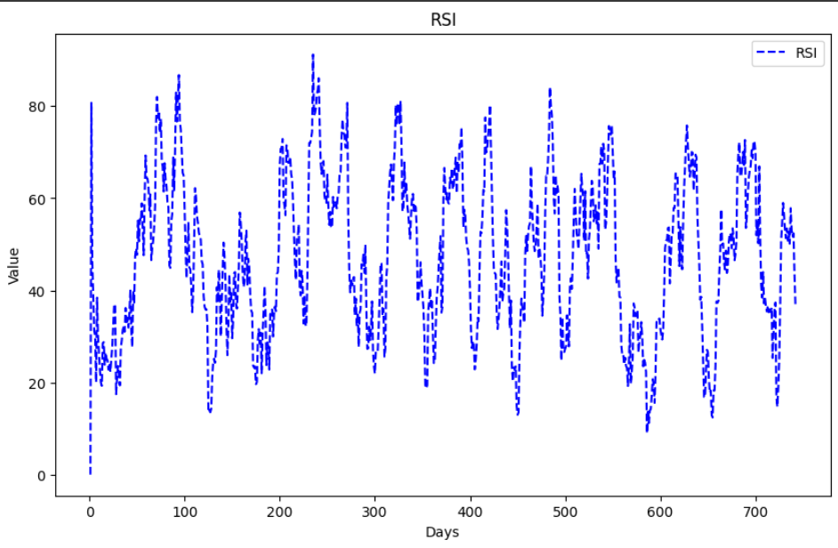

Relative Strength Index RSI
Window Size = 14 Days

Slide 7
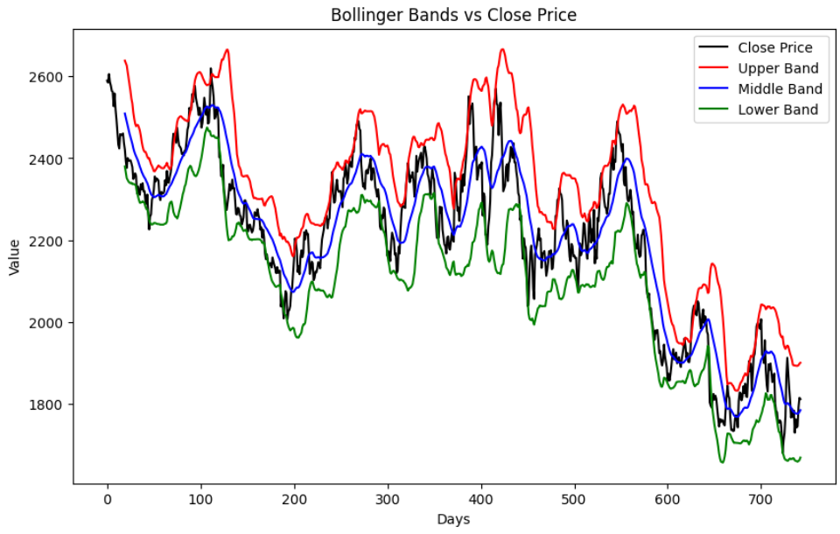
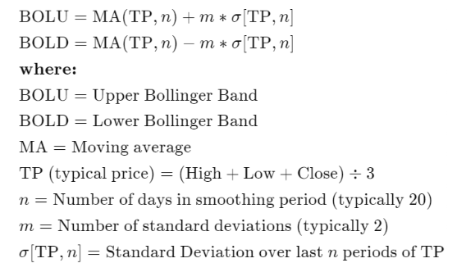
Bollinger Bands
Window Size = 20 Days

Slide 8
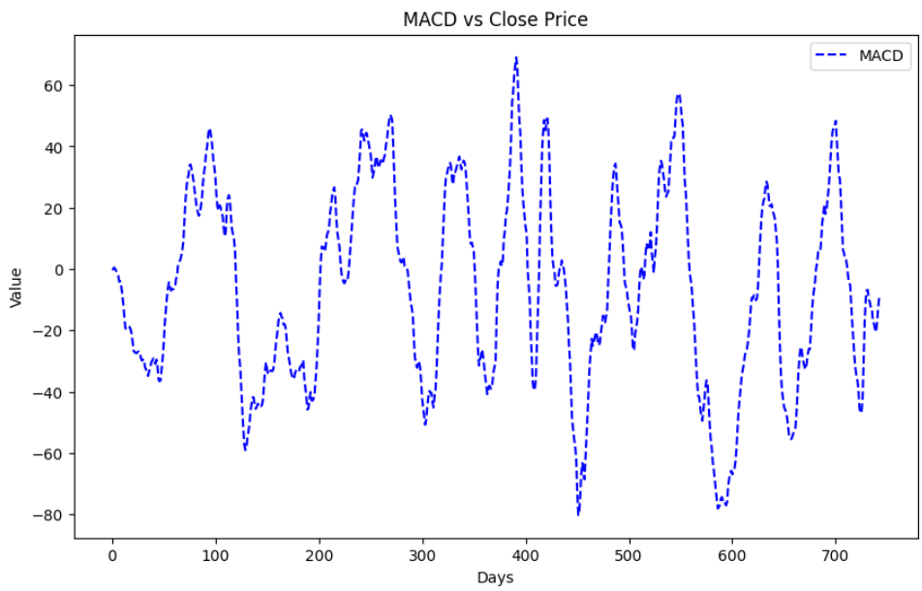
Moving Average Convergence Divergence MACD

Slide 9
Methodology
Based on the calculations of technical indicators. Correlation matrix is calculated and based on the correlation weights is assigned to each technical indicators which we called as combined indicator.
Then we compare the values obtain using the combined indicators and the closing price we get from the data.

Slide 10
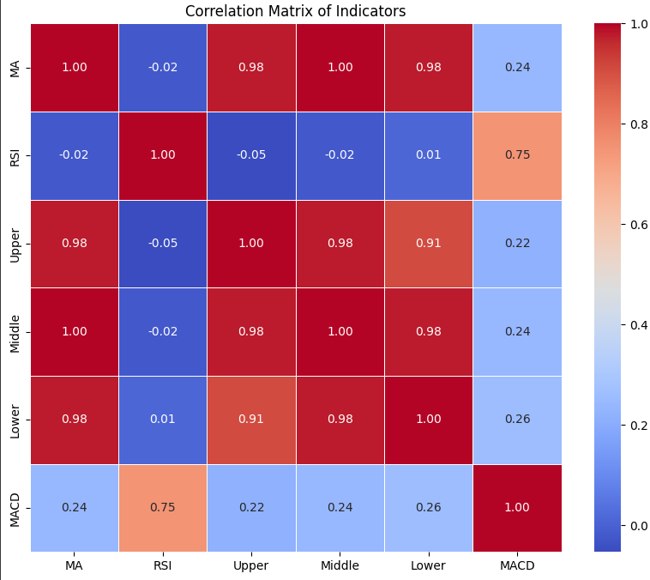
Correlation Matrix :

Slide 11
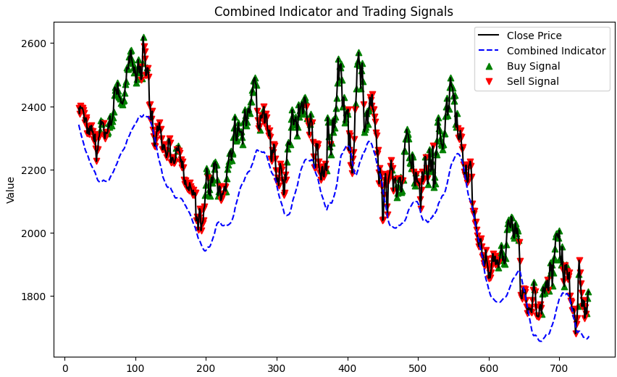
Results
Based on the plot, sell signal denotes selling and green signal denotes buying.
Based on the combined technical indicator the accuracy is 57.68%

